Slide 1
INTERNSHIP REPORT PRESENTATION
MERN Full Stack Development Virtual Internship
Presented by
SANJIV SINGH
Roll No: 2410031649
B.Tech CSE | Batch 2024–2028
AICTE ID: STU69ebb4588f93c1777054808
AICTE – EduSkills Virtual Internship Program | Aug – Oct 2026
School of Computer Science and Engineering
IILM University, Greater Noida, U.P.
Notes:
Introduce yourself, the internship and the university. This presentation covers the 8-week MERN Full Stack virtual internship and the Text Search Indexer project.

Slide 2




Internship at a Glance
Student
Sanjiv Singh
Branch
B.Tech (Computer Engineering)
8
100%
Institute
IILM University, Greater Noida
Weeks
Virtual / Online
Domain
MERN Full Stack Development + Project
Duration
August 2026 – October 2026
5
1
Reference No.
C18Y2026M101533528
Project Problems
Certificate Earned

Slide 3



Organization Profile
Organization
Domain
EduSkills Academy (EduSkills Foundation)
EdTech & Skill Development
Services
Vision
Virtual Internships
To empower students with industry-relevant skills
Offered under the patronage of AICTE and the National Internship Portal, Government of India.

Slide 4

Internship Overview & Evaluation
Mode
Online / Virtual
How we were evaluated
Week-wise structured learning plan
Duration
8 Weeks
Weekly assessments to track progress
Platform
EduSkills LMS
Project documentation and assignments
Final Assessment Test in the last week
Role
Intern
Final grade from assessments, projects and final test

Slide 5
8-Week Learning Journey
Week 1
Week 2
Week 3
Week 4
Web Setup & Core JavaScript
React Fundamentals & Hooks
Context API, Redux Toolkit & Router
TailwindCSS & React SPA
Week 5
Week 6
Week 7
Week 8
Node.js, Express & MongoDB
REST APIs & JWT Auth
Full-Stack Integration & DevOps
Capstone: E-commerce Platform
Frontend (Weeks 1–4) → Backend (Weeks 5–6) → Integration & Capstone (Weeks 7–8)

Slide 6



Project: Text Search Indexer
Problem Statement
Objectives
A system to process large volumes of text and build an efficient index for rapid searching. Text is tokenized and normalized, then stored in an inverted index mapping each word to the lines it appears on. It supports single-keyword and multi-keyword AND queries, and reports matching lines with keyword occurrence counts.
Design and implement a solution for the given problem
Use modern tools and algorithms
Optimize performance and code quality

Slide 7
Methodology
1
2
3
4
5
Tokenize
Normalize
Build Index
Search
Summarize
Split raw text into words
Lowercase, strip special characters
Map each word to its line numbers
Single and multi-keyword AND lookup
Occurrence counts per keyword
Built sequentially and modularly, each stage feeding the next.

Slide 8




Tools & Technologies
Language
Core Features
JavaScript (Node.js)
String manipulation, Array methods, Object literals
Data Structures
Concepts
Hash maps (objects) and arrays
Tokenization, Normalization, Inverted Indexing, Information Retrieval

Slide 9
Implementation: Five Problems Solved
1
Tokenize & Normalize Text
Lowercase, strip punctuation, split into clean word tokens.
2
Build Word-to-Line Index
Map every unique word to the line numbers where it occurs.
3
Single Keyword Search
Look up a keyword directly in the index for matching lines.
4
Multi-Keyword AND Search
Intersect line lists so every keyword appears on the line.
5
Occurrence Count Summary
Report how often each queried keyword appears in results.

Slide 10
Code: Tokenize & Normalize
const lines = input.split('\n');
const results = [];
for (const line of lines) {
let result;
if (line.trim() === '') {
result = { "words": [] };
} else {
const words = line
.toLowerCase()
.replace(/[^a-z0-9\s]/g, '')
.trim()
.split(/\s+/)
.filter(w => w !== '');
result = { "words": words };
}
results.push(result);
}
console.log(JSON.stringify(results));
What it does
Converts each line to lowercase
Removes non-alphanumeric characters with a regex
Splits on whitespace and drops empty tokens
Handles empty lines safely

Slide 11
Code: Index & AND Search
Inverted index
Multi-keyword AND
let index = {};
for (let i = 0; i < lines.length; i++) {
if (lines[i].trim() === '') continue;
const words = lines[i].toLowerCase()
.replace(/[^a-z0-9\s]/g, '')
.split(/\s+/);
words.forEach(word => {
if (!index[word]) index[word] = [];
if (!index[word].includes(i))
index[word].push(i);
});
}
let found = index[keywords[0]] || [];
for (let i = 1; i < keywords.length; i++) {
const next = index[keywords[i]] || [];
found = found.filter(
line => next.includes(line)
);
}
results.push(found);
Example: index = {"hello":[0,1], "world":[0,1], "test":[1]}. Query "hello test" returns line [1]; "hello" returns [0, 1].

Slide 12


Learning Outcomes
Text processing
Tokenization and normalization techniques
Inverted indexing
How indexes enable efficient text search
Search algorithms
Single and multi-keyword query design
Data structures
JavaScript objects and arrays for indexing
Problem solving
Complex string operations and search logic

Slide 13
Challenges Faced & Solutions
Challenge
Solution
Case and punctuation in matching
Multi-step normalization: lowercase plus regex to remove unwanted characters.
Efficient multi-keyword AND search
Intersected the line-number lists retrieved from the index for each keyword.
Accurate occurrence counts
Re-processed only the matched lines to count keywords, since the index tracks presence, not counts.

Slide 14
Conclusion & Future Scope
Conclusion
Future Scope
The Text Search Indexer delivers an efficient approach to text processing and retrieval. Normalization, inverted indexing, single and multi-keyword search and occurrence summaries show core data structure and algorithm principles applied to real information-access problems.
OR and NOT search operators
Fuzzy search for misspellings and variations
Search across multiple documents or files concurrently

Slide 15
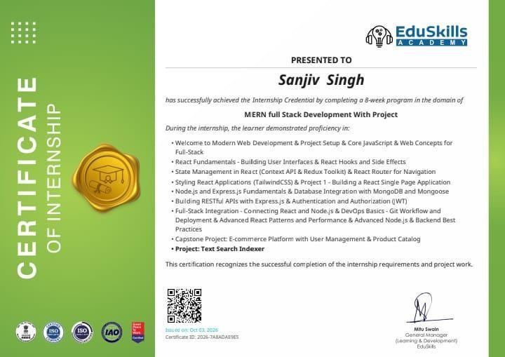
Internship Completion Certificate
Issued by
EduSkills Academy
Issued on
03 October 2026
Certificate ID
2026-7A8ADAE9E5
Project
Text Search Indexer

Slide 16
Thank You
Questions & Discussion
Sanjiv Singh | Roll No. 2410031649 | B.Tech CSE, IILM University, Greater Noida
Thanks to AICTE, EduSkills, my industry mentor and the Department of Computer Science.

